Slide 1
Unit Testing Foundations

Slide 2

About me
Vasya Rudas
Work 8+ years in SPD-Ukraine
Fan of Intellij IDEA and Kotlin language
Follow TDD and Clean Code principles
Graduated from GeekHub
Take part as GeekHub lector/assistant couple of years
Retro/Indie Gamer 👾
Learn DJ-ing and Music Production as a hobby

Slide 3
Why Unit Testing?
User story
Unit testing is when you (a programmer) write test code to verify *units* of code.
Unit can be different depending of code size

Slide 4
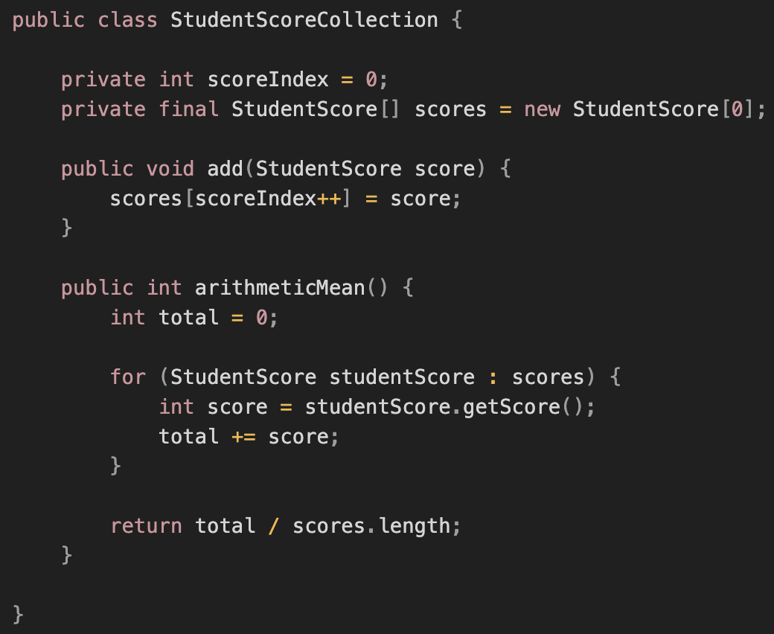
Our First Passing Test

Slide 5

Example1
Work with IDE (code structure, configuring, execution)
Fail test example
Success test example case

Slide 6
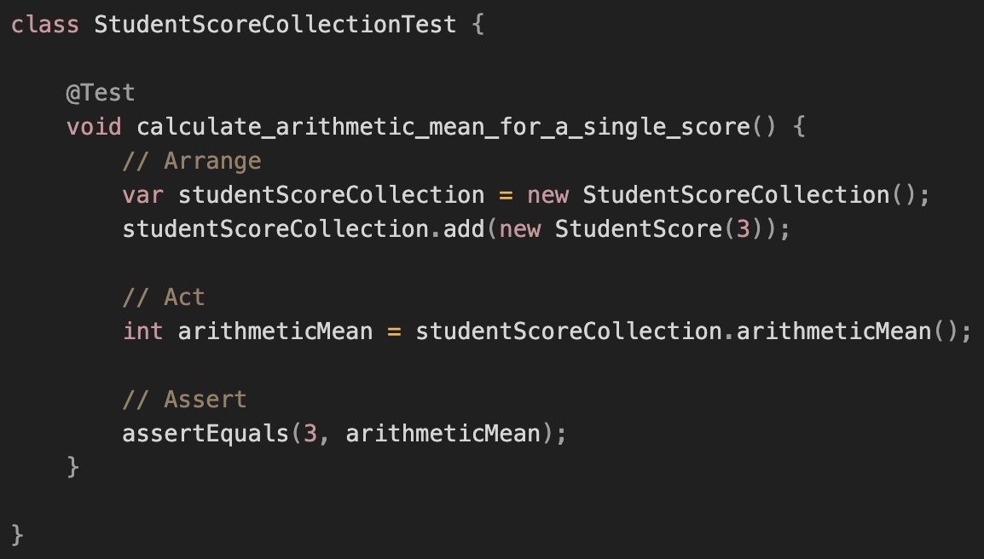
Arrange, Act, and Assert Your Way to a Test

Slide 7
Is the Test Really Testing Anything?
let’s change some things and check if test fails?
💡Deliberately fail your tests to prove they’re really doing something.

Slide 8
Ask yourself 🤔
Do I need to write additional tests to feel confident that the code works?
Could I write tests that expose defects or limitations in the class?

Slide 9
Understanding What We’re Testing
Example 2

Slide 10
Determining What Tests We Can Write
You could write *dozens* of tests against any method of reasonable complexity
You want to think instead about how many tests you ***should*** write
So firstly look at:
potentially impactful data variants
loops
`if, if-else, if-else-if` conditions
complex conditionals (math calculations, boolean logic)
what happens if value is `null` or *zero*
Calculate amount of test cases (???)

Slide 11
Writing a second test…
Example 2 - StudentScoreCollectionWithAnotherTestCaseTest

Slide 12
Initializing Tests with @Before Methods
Idea to follow DRY principle?
Code refactoring using `@Before` annotation, example #2
Which variant is better?
Other Init/Teardown methods
Clean up your tests regularly to simplify writing more tests.

Slide 13
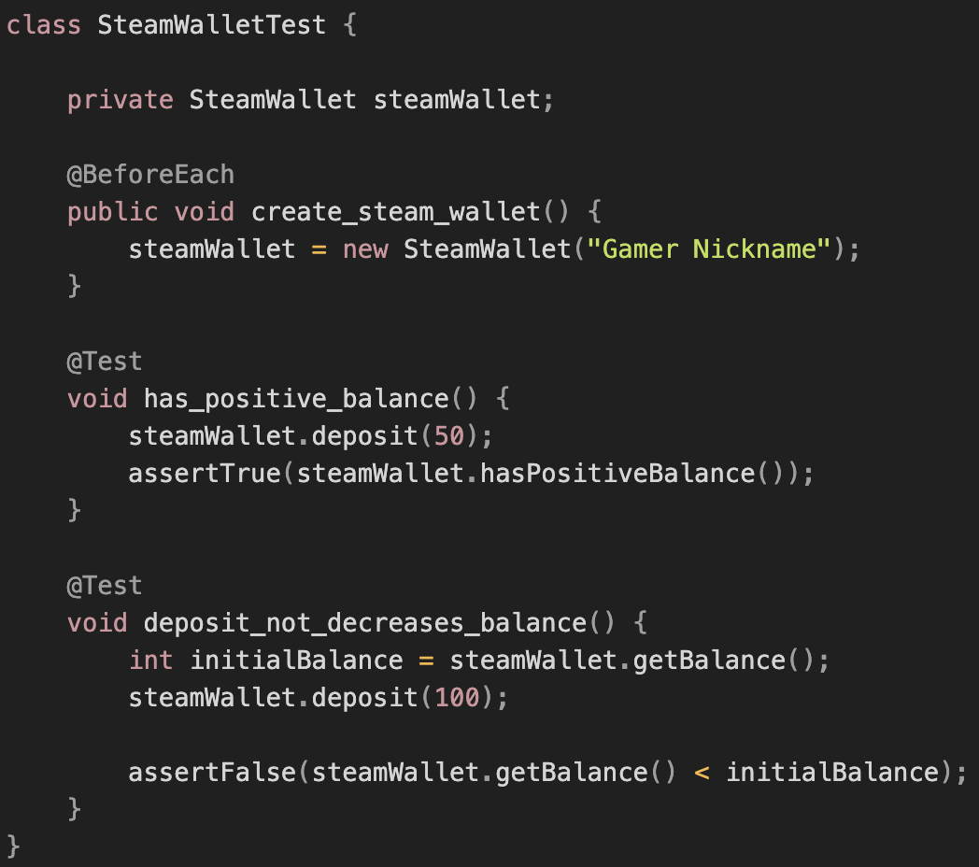
Assertions
What is assertion in general?

Slide 14
Assertions
Example 3
assertThat Something Is Equal to Another Something
Assert That exception was thrown
Checked Exceptions in test cases (code example that checked exceptions is OK in tests)

Slide 15
Write rest test cases
Code example #4
Code coverage
Line
Conditional
What optimal value ?

Slide 16
Organising Your Tests

Slide 17
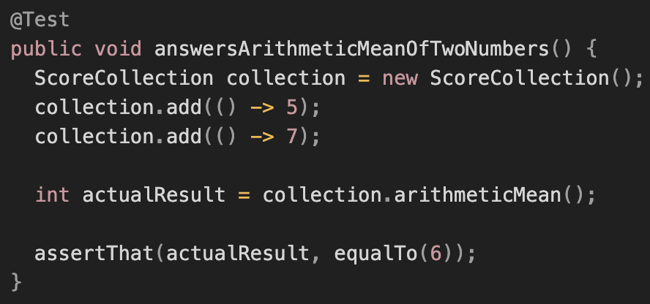
Keeping Tests Consistent with AAA

Slide 18
Keeping Tests Consistent with AAA
Arrange - before test, ensure that system is in a proper state
Act - exercise the code we want to test, usually by calling a single method
Assert - verify that the exercised code behaved as expected
[optional] After - in case some resources being allocated, ensure that they get cleaned up

Slide 19
Testing Behaviour versus Testing Methods
When you write tests, focus on the behaviours of your class, not on testing the individual methods
`SteamWallet` class with methods: `deposit()`, `withdraw()`, and `getBalance()`.
Which of them will be used in test cases?:
makeSingleDeposit
makeMultipleDeposits
makeSingleWithdrawal
makeMultipleWithdrawals
attemptToWithdrawTooMuch

Slide 20
Relationship Between Test and Production Code
Test code is dependent on production code but not otherwise
Separating Tests and Production Code

Slide 21
The Value of Focused, Single-Purpose Tests
Code example of multiple test cases in one test (assertTrue, assertFalse)
💡Split multiple cases into separate test methods, each named for the behaviour it verifies.
With separate tests we:
immediately know what behaviour went wrong when assertion fails
minimise the amount of code to read and decipher a failed test
ensure that all cases get executed

Slide 22
Tests as Documentation
document your test with obvious descriptable names
doingSomeOperationGeneratesSomeResult
someResultOccursUnderSomeCondition
givenSomeContextWhenDoingSomeBehaviorThenSomeResultOccurs
whenDoingSomeBehaviorThenSomeResultOccurs
doingSomeOperationGeneratesSomeResult
which to chose is less important than follow chosen naming across test cases

Slide 23
Tests as Documentation
Keep your tests meaningful
Improve any local-variable names.
Introduce meaningful constants.
Prefer `AssertJ` assertions. (more at https://joel-costigliola.github.io/assertj/)
Split larger tests into smaller, more-focused tests.
Move test case preparation code to helper methods and `@Before` methods.

Slide 24
Good Tests Follows Rules Of FIRST

Slide 25
Good Tests Follows Rules Of FIRST
Unit tests provide many significant benefits when crafted with care
But tests are also code that must be written and maintained

Slide 26
Problems with tests that can help to lose lots of your time 🕟
Tests that make little sense to someone following them
Tests that fail unexpectedly aka “flaky” tests
“Tests” that don’t prove anything worthwhile
Tests that require a long time to execute
Tests that don’t sufficiently cover the code
Tests that couple too tightly to implementation, meaning that small changes break lots of tests all at once
Complex tests that require a lot of code to setup

Slide 27
FIRST principles of unit testing:
[F]ast - 3 600 unit tests * each execution is 200 ms = 720 000 ms == 12 min
[I]solated:
good test verifies small chunk of code
you should be able run any one test at any time, in any order
tests are independent from each other
check rule is a Single Responsibility Principle (SRP)
[R]epeatable - Each test should produce the same results every time when it runs
[S]elf-validating:
Tests aren’t tests unless they assert that things went as expected
You write unit tests to save you time, not take more of your time
Doesn’t require manual validation of result
[T]imely
You can write unit tests at virtually any time
But when tests written first they more valued aka TDD (Test Driven Development)
Also tests written last also good(in most cases cover less conditions), especially in “legacy” code (code was written days ago before you)

Slide 28
Summary
Writing unit tests requires a serious investment in time
But your tests can repay that investment
Every test you write adds more code that you must maintain
Guard that investment by ensuring that tests retain high quality
Use the FIRST acronym to remind you of the characteristics of quality tests

Slide 29
Literature
Pragmatic Unit Testing in Java 8 with JUnit chapters 1-4 aka Part I
https://www.baeldung.com/junit-5
https://www.baeldung.com/java-unit-testing-best-practices

Slide 30
Homework
Common rules:
its not allowed to change access modifiers of existing methods
its not allowed to use any classes from Collections framework or Stream API:
`java.util.Collection and its children are not allowed to use in homework`
`java.util.stream.Stream is not allowed to use in homework`

Slide 31
Homework
Task 1 - Write tests for existing code
Task 2 - Write code for existing test cases
Task 3 - Write code and tests for Task requirements:
Test cases should include such input:
Not present input
Correct input
Incorrect input
Input with space symbols around correct value, e.g: `1 , 2,3`
Input should include special characters like `!@#$%^&()` example `1#$, &^%2 ,!!3@@`
Odd and Even number count

Slide 32
Q&A

